Slide 1
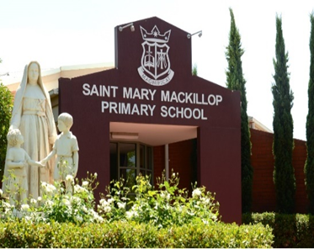
ST. MARY MACKILLOP
PRIMARY SCHOOL
152 Odessa Avenue, Keilor Downs, Vic 3038 www.mmkeilordowns.catholic.edu.au
T: 03 9367 6199
Staying Connected No.10, 26th July 2024
Dear Community,
Term 3 has certainly started with a sense of excitement and renewal. We have much to be grateful for and much to celebrate this term. As a school community, we look forward to our Book Fair commencing next week in the MPR. The children will have the opportunity to visit the Book Fair and make a wish list of books they would like to purchase throughout the Book Fair.
A number of children in Years 5 and 6 have been working along with Mrs Kandzidis in preparation for their Wakakiri performance. This is a Performing Arts Showcase for primary aged students which will be held at the Moonee Ponds Clock Tower on Wednesday 31st July. We wish all the students and staff that are preparing for the Wakakiri performance all the best and I know they will have a great time and do us proud.
Next week on Tuesday and Thursday we will be holding our online Parent, Teacher, Student Conversations. This will be an opportunity for you and your child to meet with the teacher to celebrate your child's successes at school and to discuss your child's learning. On Tuesday 30th July the children will be finishing school at 12pm and on Thursday 1st August they will finish at the normal time.
If you have not yet booked your appointment please refer
to the email sent out earlier this week or contact the school
to book in your appointment.
As we reflected at assembly on Monday about Jesus’ Grandparents Anne and Joachim we stop and think about our own Grandparents and how they often play a crucial role in shaping our values, beliefs, and sense of identity. They pass down wisdom, traditions, and a sense of continuity that connects us to our roots. Just as Anne and Joachim's faith influenced Mary and ultimately Jesus, our grandparents' guidance and love can profoundly shape our lives.
And finally, this week I heard a heart warming story from a member of the local community. Late last term a member of the community was walking along Sunshine Ave, where she tripped and fell. A number of our wonderful parents stopped and helped her up and made sure she was ok. This is a true testament to the wonderful, caring community we have here at St Mary MacKillop.
Have a great weekend everyone.
Anthony D’Amico
Principal
As Mary Mackillop said in 1899,
“May God bless you all, with all the love in my heart I pray that God may do this.”

Slide 2

If your child needs to bring a mobile phone to school it must be
handed into the teacher in the morning where it will be stored
in a secured location and returned to them in the afternoon.
Please refer to the Mobile phone policy on the school website.
As there is no supervision on the playground area in the morning,
the playground is out of bounds and children are not to play on
the playground before school.
The front drive through area between the Church and the School
operates as a drive through zone only before school.
Due to a few near misses, those who wish to park and bring
their child into class must use the back car park area.
There is now no parental parking in bays outside the front of
the Church.
REMINDERS
The basketball court is used as a carpark in the morning and afternoon. The safety of our children is of utmost importance and therefore I ask that you take extra care when driving in the carpark areas. The speed limit is 5km per hour and there is to be no double parking at all.
Please only park in the designated parking spots and do not park on the
artificial turf or in pedestrian walk ways.
Thank you for taking the safety of our children seriously.
From time to time our children forget to bring their lunch to school or a lunch order is ordered for the wrong day and we ask parents to bring in the missing lunch. In order to continue with our healthy eating expectations we ask that parents do not bring in take away food such as McDonalds, KFC etc. If you do need to purchase lunch for your child we ask that you purchase things such as sushi, sandwiches or wraps.
The School opens at 8.30am and children can enter the classroom at 8.50am. Please do not drop children off prior to 8.30am. If you need to bring your child to school before 8.30am please book them into the before school hours program.
St Mary MacKillop is a ‘Smoke Free Zone’ and smoking on the school grounds in not permitted. According to the law, ‘The Tobacco Act 1987 bans smoking or vaping on school premises or within 4 metres of any pedestrian access point to school premises.’
Please do not smoke or vape on the school grounds.

Slide 3
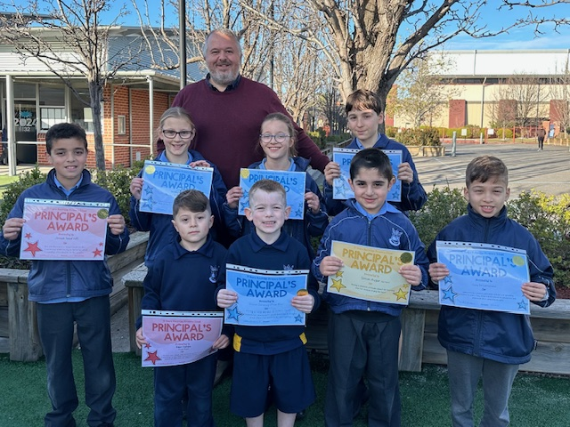
Principal’s Awards

Slide 5
.
2024 Term Dates
Term 1: 31 January-28 March 2024
(Good Friday 29 March-Easter Monday 01 April)
Term 2: 15 April-28 June 2024
Term 3: 15 July-20 September
Term 4: 7 October-17 December
(Year 6 finish Friday 13 December)

Slide 7


Slide 8


Slide 9
Upcoming Events 2024
Term 3: 15 July-20 September
Monday 29 July to Friday 2 August
Book Fair
Prep 2025 Existing Family Meetings
Tuesday 30 July and Thursday 1 August
Parent Teacher Conversations-refer email sent earlier in the week
Students finish at 12.00pm on Tuesday 30th
Normal school day Thursday 1 August
Thursday 8 August
St Mary MacKillop Feast Day
Friday 9 August
Casual clothes day-Olympic Colours-more details soon
Canteen special-see flyer
(Queen Baker Catering-QKR App)
Thursday 15 August
Feast of the Assumption
Upcoming Events 2024 Continued…..
Monday 19 August
Book Parade-details soon
Tuesday 3 September
School Closure Day-details soon
Friday 20 September
Last day of Term 3
Students finish @ 1.00pm

